Slide 1
D.R.E.A.M.
A U V R E
T L E O
A E R U
S Y N
T D
H
I
N
G
Topias Lemetyinen, Will Pope, Jennifer Tritle, Jaime Echevarria, Heather Saul, Alessio Caligaris

Slide 2
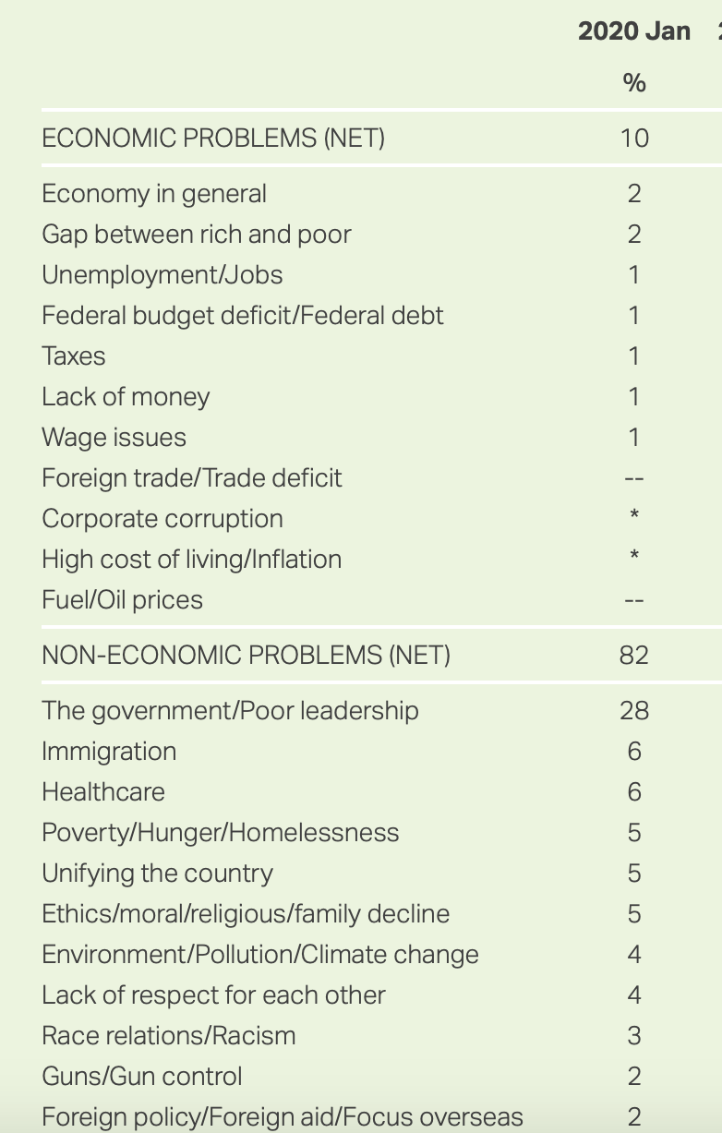
A National Problem
According to a recent Gallup poll, Americans view healthcare as one of the nation’s top 3 most important non-economic problems.
With healthcare being a focal point of many 2020 presidential candidates’ platforms, our team decided to evaluate the impact of the Affordable Care Act since it was signed into law in 2010.

Slide 3
What do we want to know?
Do areas with higher rates of uninsured persons utilize emergency services more frequently than areas with lower rates of uninsured persons?
Do areas with more uninsured persons have higher mortality rates than areas with fewer uninsured persons?
Are healthcare expenditures affected by insurance coverage - or lack thereof?

Slide 4
Hypotheses
As the proportion of uninsured population in a state increases, the rate of:
Emergency room visits should increase
Mortality should increase
Healthcare expenditure should increase

Slide 5
The Data:
Population Data: United States Census Bureau
ER Visits: Healthcare Cost and Utilization Project (HCUP)
Mortality Data: CDC Wonder
Healthcare Expenditure: Kaiser Family Foundation
Github:
Link: https://github.com/TJL30308/DREAM_Project

Slide 6
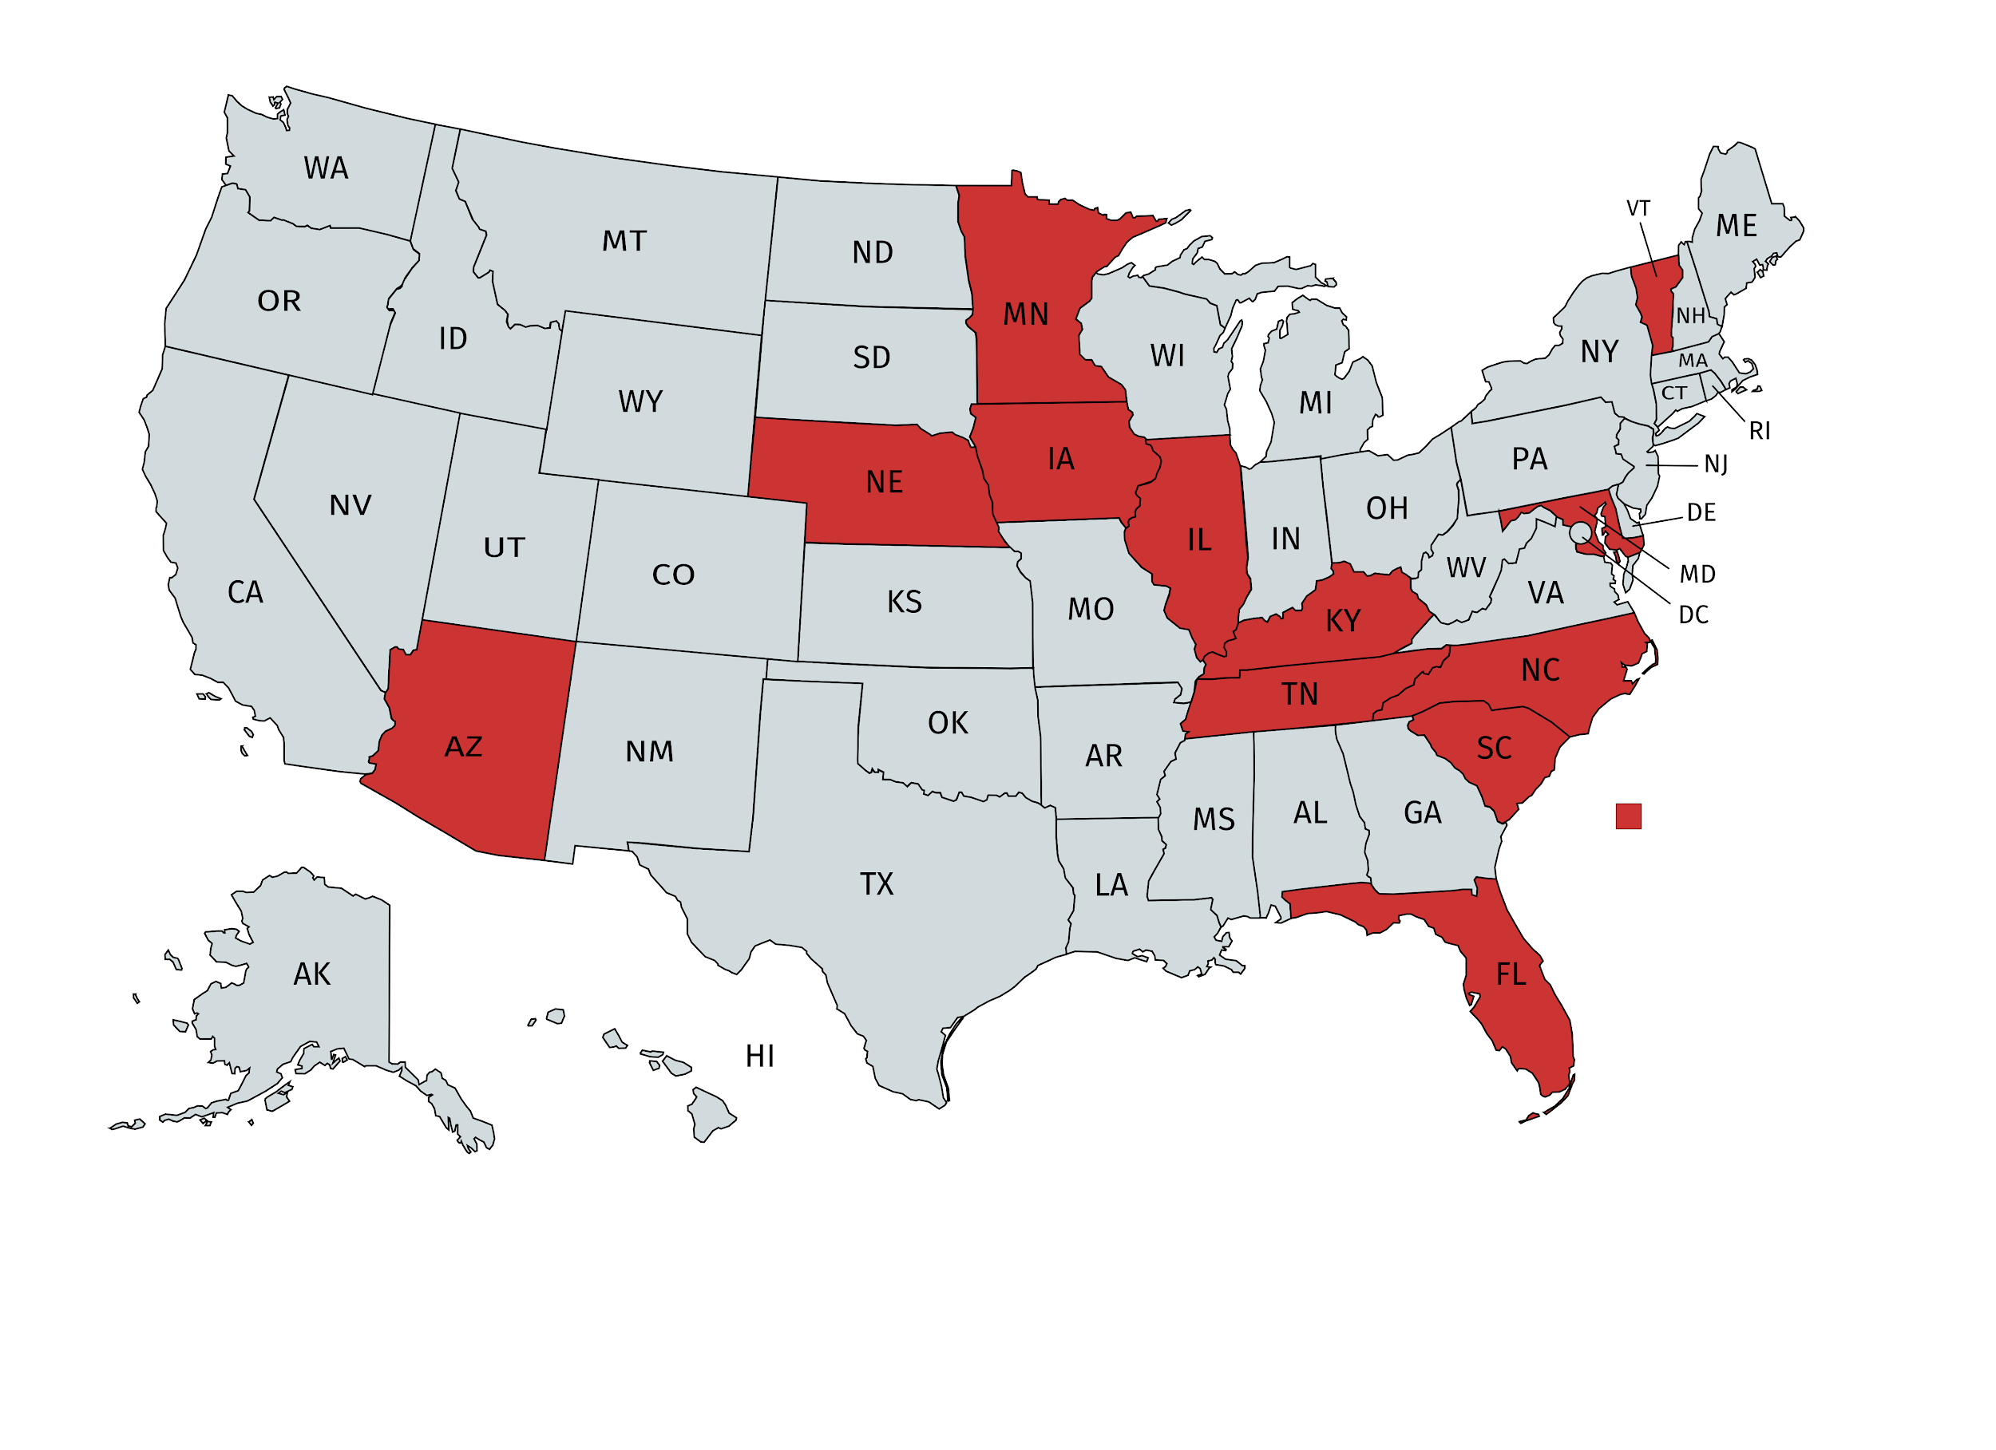
States Analyzed from 2010-2014
Arizona
Florida
Illinois
Iowa
Kentucky
Maryland
Minnesota
Nebraska
North Carolina
South Carolina
Tennessee
Vermont

Slide 7
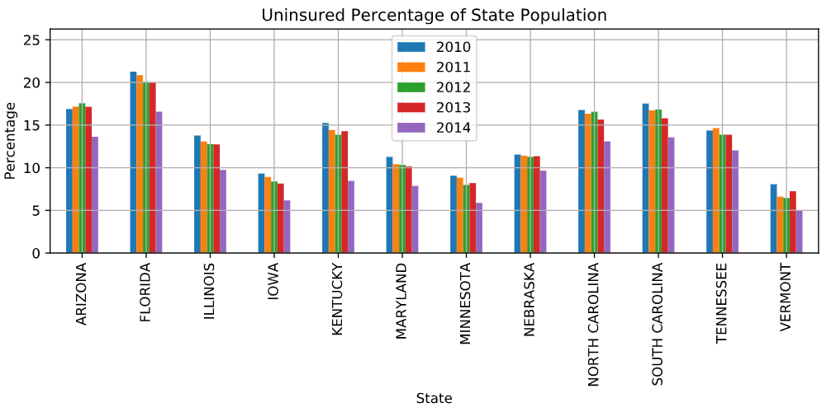

Slide 8
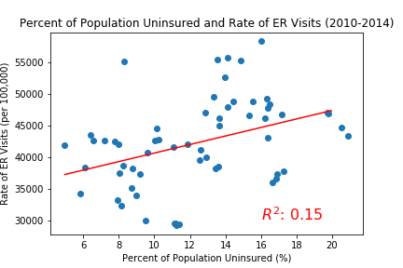
ER Visits and Uninsured (2010-2014)
Notes:
Slight positive correlation - we believe that with a larger sample size/data set the correlation would remain positive with a higher r-squared value

Slide 9
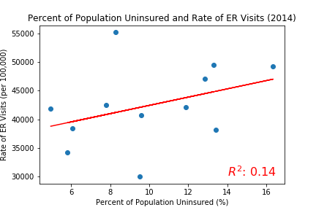
ER Visits and Uninsured 2014 (ACA Fully Enacted)

Slide 10
Findings: ER Visits and Uninsured
There was a slight positive trend between total ER Visits and the percentage of uninsured population.
The data show (very slightly) that populations with a low percent of uninsured people tend to have a lower rate of emergency room visits.

Slide 11
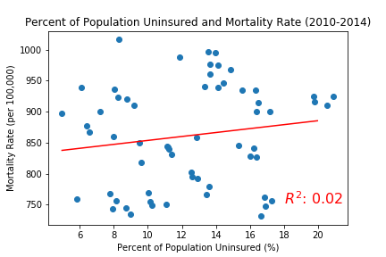
Mortality Rate and Uninsured (2010-2014)

Slide 12
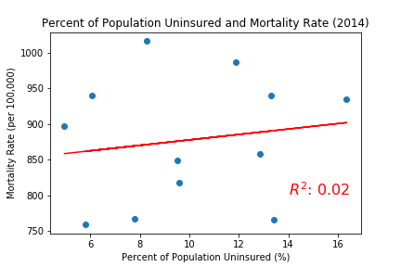
Mortality Rate and Uninsured 2014 (ACA Fully Enacted)

Slide 13
Findings: Mortality Rate and Uninsured
There was a slight positive trend between mortality rates and the percentage of uninsured people.
The data appear to show that populations with a higher percent of uninsured people tend to have higher mortality rates.

Slide 14
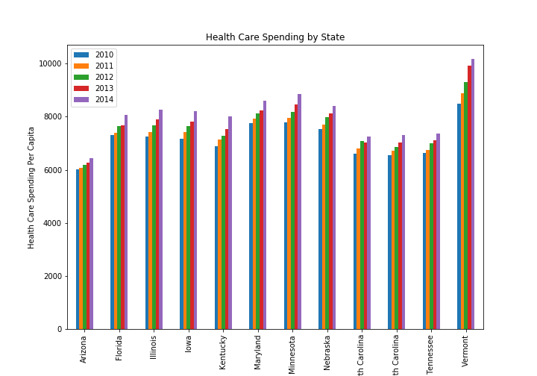

Slide 15
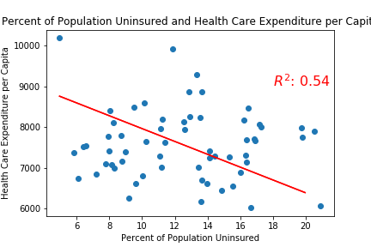
Health Expenditure and Uninsured (2010-2014)

Slide 16
Findings: Healthcare expenditures and Uninsured
There is a negative trend between uninsured rates and healthcare expenditures. This is the opposite of what we expected.
The dataset defines healthcare expenditure as public and private
This increase could be as a result of subsidies
This does show there is a short term increase but it does not show long term trends
People could be using more services as uninsured goes down.

Slide 17
2010 to 2014 Statistical Testing
To test our hypotheses, we looked at the starting data set from 2010, when the Affordable Care Act was passed, and the final data set we are analyzing from 2014.
Since we are comparing the mean of two populations, we decided to use a t-test to determine if there is any statistical significance.
2010 Mortality Rate vs. 2014 Mortality Rate
Statistic -0.9021450507239777
Pvalue 0.37675124671096905
2010 Emergency Room Visits vs. 2014 Emergency Room Visits
Statistic -0.25028800778910976
Pvalue 0.8046871373654417
2010 Healthcare Expenditure vs. 2014 Healthcare Expenditure
Statistic -2.735810067710718
Pvalue 0.012066599112181877
The only comparison in which we found a statistically significant (.05 p-value or less) difference was in healthcare expenditures in 2010 vs. healthcare expenditures in 2014.

Slide 18
Key Findings
Hypothesis: An increase in uninsured rates will increase ER visits
There is a slight positive trend and a weak correlation between uninsured rates and ER visits. We believe that this would change with a larger data set.
Hypothesis: An increase in uninsured rates will increase mortality rates
There is a slight positive trend and a weak correlation between uninsured rates and overall mortality rates. We believe this is because overall mortality rates confound key data factors in analysis (more on the next slide).
Hypothesis: An increase in uninsured rates will increase healthcare expenditures
There is a negative trend and a moderate correlation between healthcare expenditures per capita and uninsured rates. This could be because in the short term healthcare expenditures increase at the beginning of a health policy change (as Alessio explained previously)

Slide 19
Data Limitations
Data limited to only 12 States
Time period limited to 2010 - 2014 (ACA passed 2010)
Hard to draw significant conclusions with small data set
Literature reviews suggests that overall mortality data is less meaningful without data concerning preventable vs. non preventable deaths, short and long-term mortality
Some states like Florida, due to age demographics and other factors, will have naturally higher mortality rates

Slide 20
Challenges
Compiling data from mixed data sources
Wrangling of certain data sets required manual manipulation
Identifying a project with an appropriate scope with the data available
We needed to change our project very quickly from our original idea because lack of API
Applying the Github workflow

